Slide 1
Project Management

Slide 2
Organization of this Lecture:
Introduction to Project Planning
Software Cost Estimation
  Cost Estimation Models
  Software Size Metrics
  Empirical Estimation
  Heuristic Estimation
  COCOMO
Staffing Level Estimation
Effect of Schedule Compression on Cost
Summary

Slide 3
Introduction
Many software projects fail:
  due to faulty project management practices:
    It is important to learn different aspects of software project management.

Slide 4
Introduction
Goal of software project management:
  enable a group of engineers to work efficiently towards successful completion of a software project.

Slide 5
Responsibility of project managers
Project proposal writing,
Project cost estimation,
Scheduling,
Project staffing,
Project monitoring and control,
Software configuration management,
Risk management,
Managerial report writing and presentations, etc.

Slide 6
Introduction
A project manager’s activities are varied.
  can be broadly classified into:
    project planning,
    project monitoring and control activities.

Slide 7
Project Planning
Once a project is found to be feasible,
  project managers undertake project planning.

Slide 8
Project Planning Activities
Estimation:
  Effort, cost, resource, and project duration
Project scheduling:
Staff organization:
  staffing plans
Risk handling:
  identification, analysis, and abatement procedures
Miscellaneous plans:
  quality assurance plan, configuration management plan, etc.

Slide 9
Project planning
Requires utmost care and attention --- commitments to unrealistic time and resource estimates result in:
  irritating delays.
  customer dissatisfaction
  adverse affect on team morale
    poor quality work
  project failure.

Slide 10
Sliding Window Planning
Involves project planning over several stages:
  protects managers from making big commitments too early.
  More information becomes available as project progresses.
    Facilitates accurate planning

Slide 11
SPMP Document
After planning is complete:
  Document the plans:
  in a Software Project Management Plan(SPMP) document.

Slide 12
Organization of SPMP Document
  Introduction (Objectives,Major Functions,Performance Issues,Management and Technical Constraints)
  Project Estimates (Historical Data,Estimation Techniques,Effort, Cost, and Project Duration Estimates)
  Project Resources Plan (People,Hardware and Software,Special Resources)
  Schedules (Work Breakdown Structure,Task Network, Gantt Chart Representation,PERT Chart Representation)
  Risk Management Plan (Risk Analysis,Risk Identification,Risk Estimation, Abatement Procedures)
  Project Tracking and Control Plan
  Miscellaneous Plans (Process Tailoring,Quality Assurance)

Slide 13
Software Cost Estimation
Determine size of the product.
From the size estimate,
  determine the effort needed.
From the effort estimate,
  determine project duration, and cost.

Slide 14
Software Cost Estimation
Effort Estimation
Cost Estimation
Size Estimation
Staffing Estimation
Duration Estimation
Scheduling

Slide 15
Software Cost Estimation
Three main approaches to estimation:
  Empirical
  Heuristic
  Analytical

Slide 16
Software Cost Estimation Techniques
Empirical techniques:
  an educated guess based on past experience.
Heuristic techniques:
  assume that the characteristics to be estimated can be expressed in terms of
  some mathematical expression.
Analytical techniques:
  derive the required results starting from certain simple assumptions.

Slide 17
Software Size Metrics
LOC (Lines of Code):
  Simplest and most widely used metric.
  Comments and blank lines should not be counted.

Slide 18
Disadvantages of Using LOC
Size can vary with coding style.
Focuses on coding activity alone.
Correlates poorly with quality and efficiency of code.
Penalizes higher level programming languages, code reuse, etc.

Slide 19
Disadvantages of Using LOC (cont...)
Measures lexical/textual complexity only.
  does not address the issues of structural or logical complexity.
Difficult to estimate LOC from problem description.
  So not useful for project planning

Slide 20
Function Point Metric
Overcomes some of the shortcomings of the LOC metric
Proposed by Albrecht in early 80's:
  FP=4 * #inputs + 5 * #Outputs + 4 * #inquiries + 10 * #files + 10 * #interfaces
Input:
  A set of related inputs is counted as one input.

Slide 21
Function Point Metric
Output:
  A set of related outputs is counted as one output.
Inquiries:
  Each user query type is counted.
Files:
  Files are logically related data and thus can be data structures or physical files.
Interface:
  Data transfer to other systems.

Slide 22
Function Point Metric (CONT.)
Suffers from a major drawback:
  the size of a function is considered to be independent of its complexity.
Extend function point metric:
  Feature Point metric:
  considers an extra parameter:
    Algorithm Complexity.

Slide 23
Function Point Metric (CONT.)
Proponents claim:
  FP is language independent.
  Size can be easily derived from problem description
Opponents claim:
  it is subjective --- Different people can come up with different estimates for the same problem.

Slide 24
Empirical Estimation Techniques
Expert Judgement:
  An euphemism for guess made by an expert.
  Suffers from individual bias.
Delphi Estimation:
  overcomes some of the problems of expert judgement.

Slide 25
Expert judgement
Experts divide a software product into component units:
  e.g. GUI, database module, data communication module, billing module, etc.
Add up the guesses for each of the components.

Slide 26
Delphi Estimation:
Team of Experts and a coordinator.
Experts carry out estimation independently:
  mention the rationale behind their estimation.
  coordinator notes down any extraordinary rationale:
    circulates among experts.

Slide 27
Delphi Estimation:
Experts re-estimate.
Experts never meet each other
  to discuss their viewpoints.

Slide 28
Heuristic Estimation Techniques
Single Variable Model:
  Parameter to be Estimated=C1*(Estimated Characteristic)^{d1}
Multivariable Model:
  Assumes that the parameter to be estimated depends on more than one characteristic.
  Parameter to be Estimated=C1*(Estimated Characteristic)^{d1}+ C2*(Estimated Characteristic)^{d2}+…
  Usually more accurate than single variable models.

Slide 29
COCOMO Model
COCOMO (COnstructive COst MOdel) proposed by Boehm.
Divides software product developments into 3 categories:
  Organic
  Semidetached
  Embedded

Slide 30
Elaboration of Product classes
Organic:
  Relatively small groups
    working to develop well-understood applications.
Semidetached:
  Project team consists of a mixture of experienced and inexperienced staff.
Embedded:
  The software is strongly coupled to complex hardware, or real-time systems.

Slide 31
COCOMO Model (CONT.)
For each of the three product categories:
  From size estimation (in KLOC), Boehm provides equations to predict:
    project duration in months
    effort in programmer-months
Boehm obtained these equations:
  examined historical data collected from a large number of actual projects.

Slide 32
COCOMO Model (CONT.)
Software cost estimation is done through three stages:
  Basic COCOMO,
  Intermediate COCOMO,
  Complete COCOMO.

Slide 33
Basic COCOMO Model (CONT.)
Gives only an approximate estimation:
  Effort = a1*(KLOC)^{a2} PM
  Tdev = b1*(Effort)^{b2} Months
    KLOC is the estimated kilo lines of source code,
    a1,a2,b1,b2 are constants for different categories of software products,
    Tdev is the estimated time to develop the software in months,
    Effort estimation is obtained in terms of person months (PMs).

Slide 34
Development Effort Estimation
Organic :
  Effort = 2.4*(KLOC)^{1.05} PM
Semi-detached:
  Effort = 3.0*(KLOC)^{1.12} PM
Embedded:
  Effort = 3.6*(KLOC)^{1.20}PM

Slide 35
Development Time Estimation
Organic:
  Tdev = 2.5*(Effort)^{0.38} Months
Semi-detached:
  Tdev = 2.5*(Effort)^{0.35} Months
Embedded:
  Tdev = 2.5*(Effort)^{0.32} Months

Slide 36
Basic COCOMO Model (CONT.)
Effort is somewhat super-linear in problem size.
Semidetached
Effort
Embedded
Organic
Size

Slide 37
Basic COCOMO Model (CONT.)
Development time
  sublinear function of product size.
When product size increases two times,
  development time does not double.
Time taken:
  almost same for all the three product categories.
Dev. Time
Embedded
Semidetached
18 Months
14 Months
Organic
30K
60K
Size

Slide 38
Basic COCOMO Model (CONT.)
Development time does not increase linearly with product size:
  For larger products more parallel activities can be identified:
    can be carried out simultaneously by a number of engineers.

Slide 39
Basic COCOMO Model (CONT.)
Development time is roughly the same for all the three categories of products:
  For example, a 60 KLOC program can be developed in approximately 18 months
    regardless of whether it is of organic, semi-detached, or embedded type.
  There is more scope for parallel activities for system and application programs,
    than utility programs.

Slide 40
Example
The size of an organic software product has been estimated to be 32,000 lines of source code.
Effort = 2.4*(32)^{1.05} = 91 PM
Nominal development time = 2.5*(91)^{0.38} = 14 months

Slide 41
Intermediate COCOMO
Basic COCOMO model assumes
  effort and development time depend on product size alone.
However, several parameters affect effort and development time:
    Reliability requirements
    Availability of CASE tools and modern facilities to the developers
    Size of data to be handled

Slide 42
Intermediate COCOMO
For accurate estimation,
  the effect of all relevant parameters must be considered:
  Intermediate COCOMO model recognizes this fact:
    refines the initial estimate obtained by the basic COCOMO by using a set of 15 cost drivers (multipliers).

Slide 43
Intermediate COCOMO (CONT.)
If modern programming practices are used,
  initial estimates are scaled downwards.
If there are stringent reliability requirements on the product :
  initial estimate is scaled upwards.

Slide 44
Intermediate COCOMO (CONT.)
Rate different parameters on a scale of one to three:
  Depending on these ratings,
    multiply cost driver values with the estimate obtained using the basic COCOMO.

Slide 45
Intermediate COCOMO (CONT.)
Cost driver classes:
  Product: Inherent complexity of the product, reliability requirements of the product, etc.
  Computer: Execution time, storage requirements, etc.
  Personnel: Experience of personnel, etc.
  Development Environment: Sophistication of the tools used for software development.

Slide 46
Shortcoming of basic and intermediate COCOMO models
Both models:
  consider a software product as a single homogeneous entity:
  However, most large systems are made up of several smaller sub-systems.
    Some sub-systems may be considered as organic type, some may be considered embedded, etc.
    for some the reliability requirements may be high, and so on.

Slide 47
Complete COCOMO
Cost of each sub-system is estimated separately.
Costs of the sub-systems are added to obtain total cost.
Reduces the margin of error in the final estimate.

Slide 48
Complete COCOMO Example
A Management Information System (MIS) for an organization having offices at several places across the country:
  Database part (semi-detached)
  Graphical User Interface (GUI) part (organic)
  Communication part (embedded)
Costs of the components are estimated separately:
  summed up to give the overall cost of the system.

Slide 49
Halstead's Software Science
An analytical technique to estimate:
  size,
  development effort,
  development time.

Slide 50
Halstead's Software Science
Halstead used a few primitive program parameters
  number of operators and operands
Derived expressions for:
  over all program length,
  actual volume
  etc.

Slide 51
Halstead's Software Science
Let:
N1: total number of operators
N2: total number of operands
n1: number of unique operators
n2: number of unique operands

Slide 52
Halstead's Software Science
Program length = N = N1+N2 = n₁*log₂n₁ + n₂*log₂n₂
Program volume = V = N*log₂(n₁+n₂)

Slide 53
Staffing
A common misconception:
  one software engineer is as productive as another:
Experiments reveal:
  a large variation in productivity between the worst and best in a scale of 1 to 10.
  Worst engineers even help reduce the overall productivity of the team
    in effect exhibit negative productivity.

Slide 54
Who is a Good Software Engineer?
Good programming abilities
Good knowledge of the project areas (Domain)
Exposure to Systematic Techniques
Fundamental Knowledge of Computer Science
Ability to work in a team
Intelligence
Good communication skills:
  Oral
  Written
  Interpersonal
High Motivation

Slide 55
Who is a Good Software Engineer? (cont.)
Studies show:
  these attributes vary as much as
  1:30 for poor and bright candidates.
Technical knowledge in the area of the project (domain knowledge) is an important factor, determines:
  productivity of an individual
  quality of the product he develops.

Slide 56
Who is a Good Software Engineer? (cont.)
A programmer having thorough knowledge of database applications (e.g MIS):
  may turn out to be a poor data communication engineer.

Slide 57
Scheduling
Scheduling is an important activity for the project managers.
To determine project schedule:
  Identify tasks needed to complete the project.
  Determine the dependency among different tasks.
  Determine the most likely estimates for the duration of the identified tasks.
  Plan the starting and ending dates for various tasks.

Slide 58
Work Breakdown Structure
Work Breakdown Structure (WBS) provides a notation for representing task structure:
  Activities are represented as nodes of a tree.
  The root of the tree is labelled by the problem name.
  Each task is broken down into smaller tasks and represented as children nodes.
It is not useful to subdivide tasks into units which take less than a week or two to execute.
  Finer subdivisions mean that a large amount of time must be spent on estimating and chart revision.

Slide 59
Work Breakdown Structure
Compiler Project
Requirements
Design
Code
Test
Write Manual
Lexer
Parser
Code Generator

Slide 60
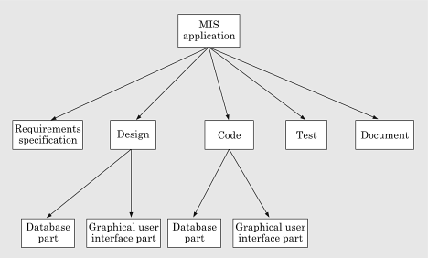
Work Breakdown Structure

Slide 61
Activity Networks
WBS structure can be refined into an activity network representation:
  Network of boxes and arrows
  shows different tasks making up a project,
  represents the ordering (interdependencies) among the tasks
  Estimated duration of each task represented

Slide 62
Activity Network
Code Lexer
Design
Code Parser
Requirements
Test
Code Code Generator
Write Manual

Slide 63
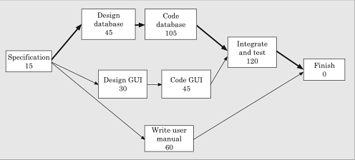
Activity Network

Slide 64
Critical Path
Task dependencies define a partial ordering among tasks, i.e.
  Completion of some tasks must precede the starting time of some other tasks.
A critical path:
  along which every milestone is critical to meeting the project deadline.
A Critical Path is a chain of tasks that determine the duration of the project.

Slide 65
Critical Paths
A critical paths is sequence of tasks such that
  a delay in any of the tasks will cause a delay to the entire project.
There can be more than one critical path in a project.
It is important for the project manager to be aware of the critical paths in a project:
  can ensure that tasks on these paths are completed on time.

Slide 66
Critical Paths
Other tasks may have some room for delay without affecting the entire project.
  If necessary, the manager may switch resources from a noncritical task to a critical task.
Several software packages are available for automating the scheduling process:
  MacProject on Apple Macintosh computer
  MS-Project on Microsoft Windows Operating System.

Slide 67
Critical Path Management
Critical Path Management(CPM) is a technique for:
  Identifying critical paths
  Managing project.
The CPM technique is not specific to software engineering
  has a much wider use.

Slide 68
Critical Path Management
CPM can assist in answering questions like:
  What are the critical paths in the project?
  What is the shortest time in which the project can be completed?
  What is the earliest (or latest) time a task can be started (or finished) without delaying the project?

Slide 69
How do we work out the various start and finish times for tasks?
Minimum time to complete project (MT) = Maximum of all paths from start to finish
Earliest start time (ES) of a task = Maximum of all paths from start to this task
Earliest finish time (EF) of a task = ES + duration of the task
Latest finish time (LF) of a task = MT - Maximum of all paths from this task to finish, excluding this task
Latest start time (LS) of a task = LF - duration of the task
Slack time (ST) = LS - ES = LF - EF

Slide 70
Activity Network

Slide 71
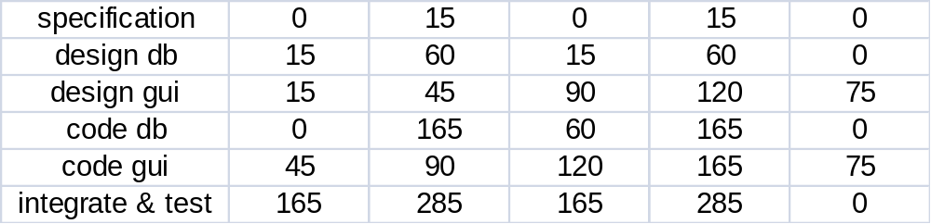
Start and finish times for tasks.
MT = 285
Task ES EF LS LF ST
Critical tasks: specification -> design db -> code db -> integrate & test

Slide 72
What are the float time (or slack time) of tasks?
Float time (or slack time) is the total time that a task may be delayed
  before it will affect the end time of the project.
The float times indicate the "flexibility" in starting and completion of tasks:
A critical activity is an activity with zero (0) slack or float time.

Slide 73
Gantt Charts
Named after its developer Henry Gantt.
  a form of bar chart:
    each bar represents an activity,
    bars are drawn against a time line,
    length of each bar is proportional to the length of time planned for the activity.

Slide 74
Gantt Charts
Gantt charts are not specific to software engineering.
Gantt charts used in software project management are:
  enhanced version of standard Gantt charts.
  colored part of a bar shows the length of time a task is estimated to take.
  white part shows the slack time,
    the latest time by which a task must be finished.

Slide 75
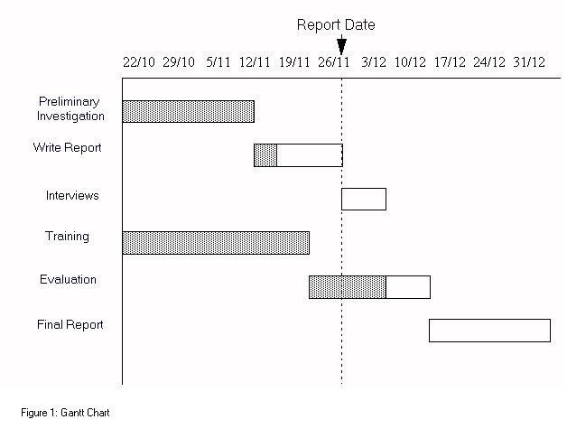
Gantt Chart

Slide 76
Gnatt and PERT Charts
While Gantt charts show the different tasks and their durations clearly:
  they do not show intertask dependencies explicitly.
  this shortcoming of Gantt charts is overcome by PERT charts.

Slide 77
What is PERT and how does it work?
PERT (Program Evaluation and Review Technique) is a variation of CPM:
  incorporates uncertainty about duration of tasks.
Gantt chart representation of schedule is helpful in planning the utilization of resources,
  while PERT chart is more useful for monitoring the timely progress of activities.

Slide 78


PERT chart

Slide 79
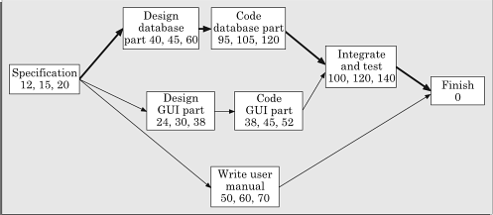
PERT chart

Slide 80
Scheduling
Many managers believe
  an aggressive schedule motivates the engineers to do a better and faster job.
  However, careful experiments show:
    unrealistic aggressive schedules cause engineers to compromise on intangible quality aspects,
      also cause schedule delays.

Slide 81
Scheduling
A good way to achieve accuracy:
  let people set their own schedules.
Schedule for a large-sized task may take too long:
  Managers need to break large tasks into smaller ones to find more parallelism
    can lead to shorter development time.
    Small-sized tasks help in better tracking

Slide 82
Summary
We discussed the broad responsibilities of the project manager:
  Project planning
  Project Monitoring and Control

Slide 83
Summary
To estimate software cost:
  Determine size of the product.
  Using size estimate,
    determine effort needed.
  From the effort estimate,
    determine project duration, and cost.

Slide 84
Summary (CONT.)
Cost estimation techniques:
  Empirical Techniques
  Heuristic Techniques
  Analytical Techniques
Empirical techniques:
  based on systematic guesses by experts.
    Expert Judgement
    Delphi Estimation

Slide 85
Summary (CONT.)
Heuristic techniques:
  assume that characteristics of a software product can be modeled by a mathematical expression.
  COCOMO
Analytical techniques:
  derive the estimates starting with some basic assumptions:
  Halstead's Software Science

Slide 86
Summary (CONT.)
The staffing level during the life cycle of a software product development:
  follows Rayleigh curve
  maximum number of engineers required during testing.

Slide 87
Summary (CONT.)
Relationship between schedule change and effort:
  highly nonlinear.
Software organizations are usually organized in:
  functional format
  project format

Slide 88
Summary (CONT.)
Project teams can be organized in following ways:
  Chief programmer: suitable for routine work.
  Democratic: Small teams doing R&D type work
  Mixed: Large projects

